Slide 1
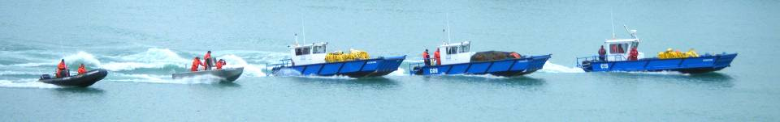
ECRC~SIMEC
Bakken Crude Oil Spill Response
From July 6, 2013 Train Incident
Lac Megantic, Quebec
Notes:
Welcome & Introductions

Slide 2
Oil Volume
(as reported by CBC July 29 2013)
7,200,000 litres of bakken crude oil on train
900,000 litres of oil not spilled inside 9 intact cars
670,000 litres of oil that was recovered from damaged cars
5,630,000 litres of crude oil that was burned or spilled into the environment

Slide 3
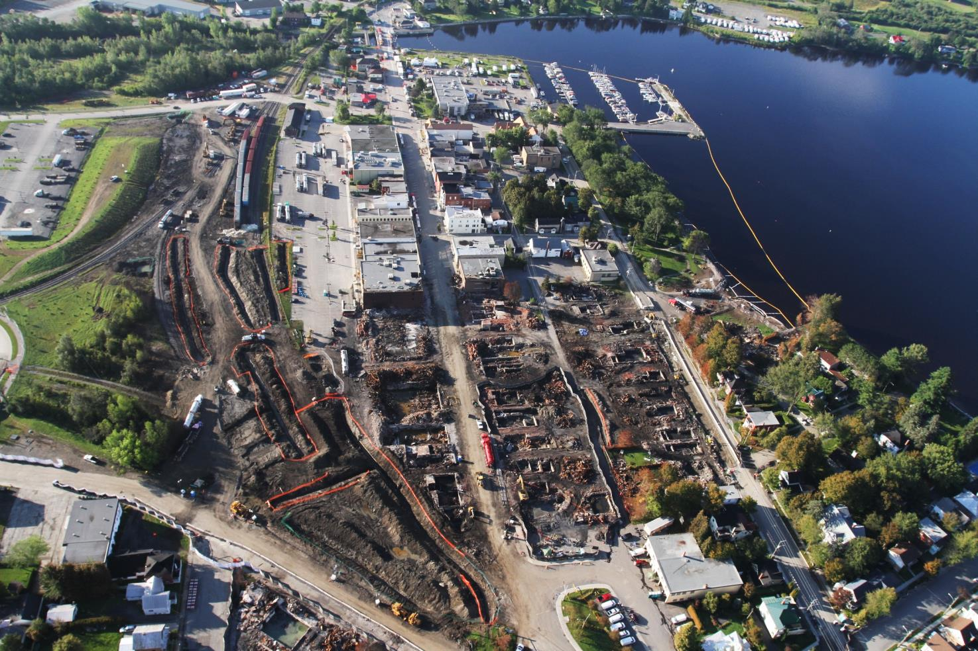
Incident Site – Lac Megantic

Slide 4
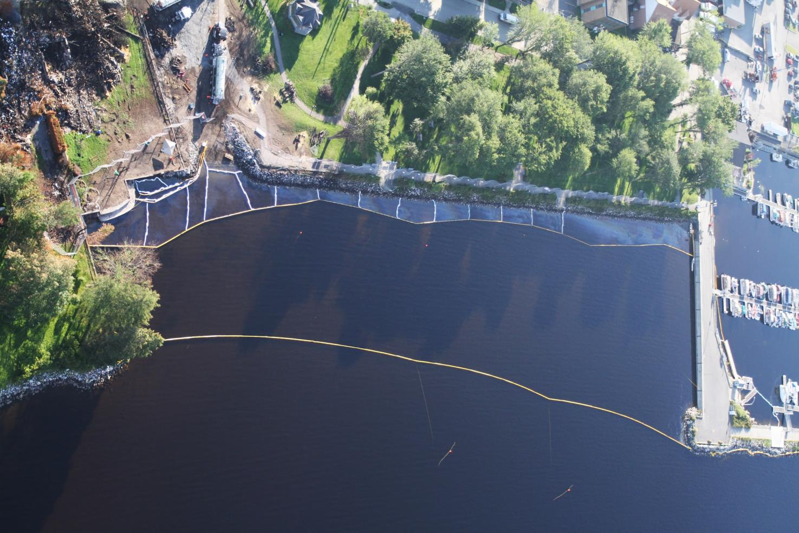
Water Entry Point – Lac Megantic

Slide 5
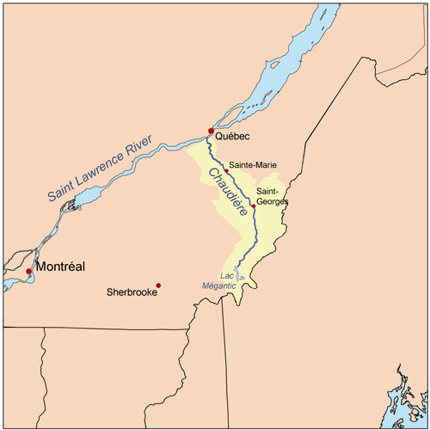
River Background Information
Chaudière River - source near Lac Megantic
Drainage area is approx. 6,682 square kilometres
Water level could change by 50 cm or 20”
185 Km long
Has 3 control dam’s
Rocky bottom in river

Slide 6
Use of Control Dams
After the incident occurred the control dams were lowered in an attempt to control the spread of oil
Threat of flooding from a storm however meant dams could not remain closed indefinitely
Resulting in some uncontained surface oil dropping with decreasing water level in river

Slide 7
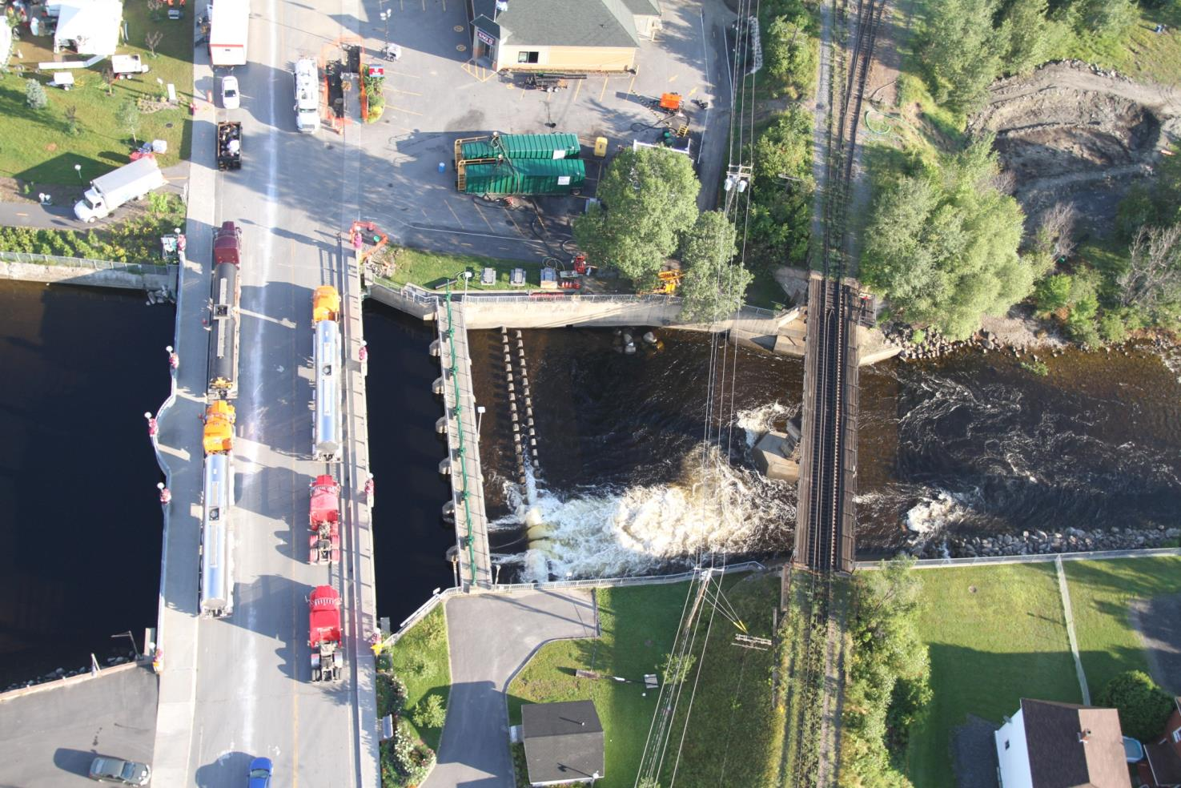
Lac Megantic – Control Dam

Slide 8
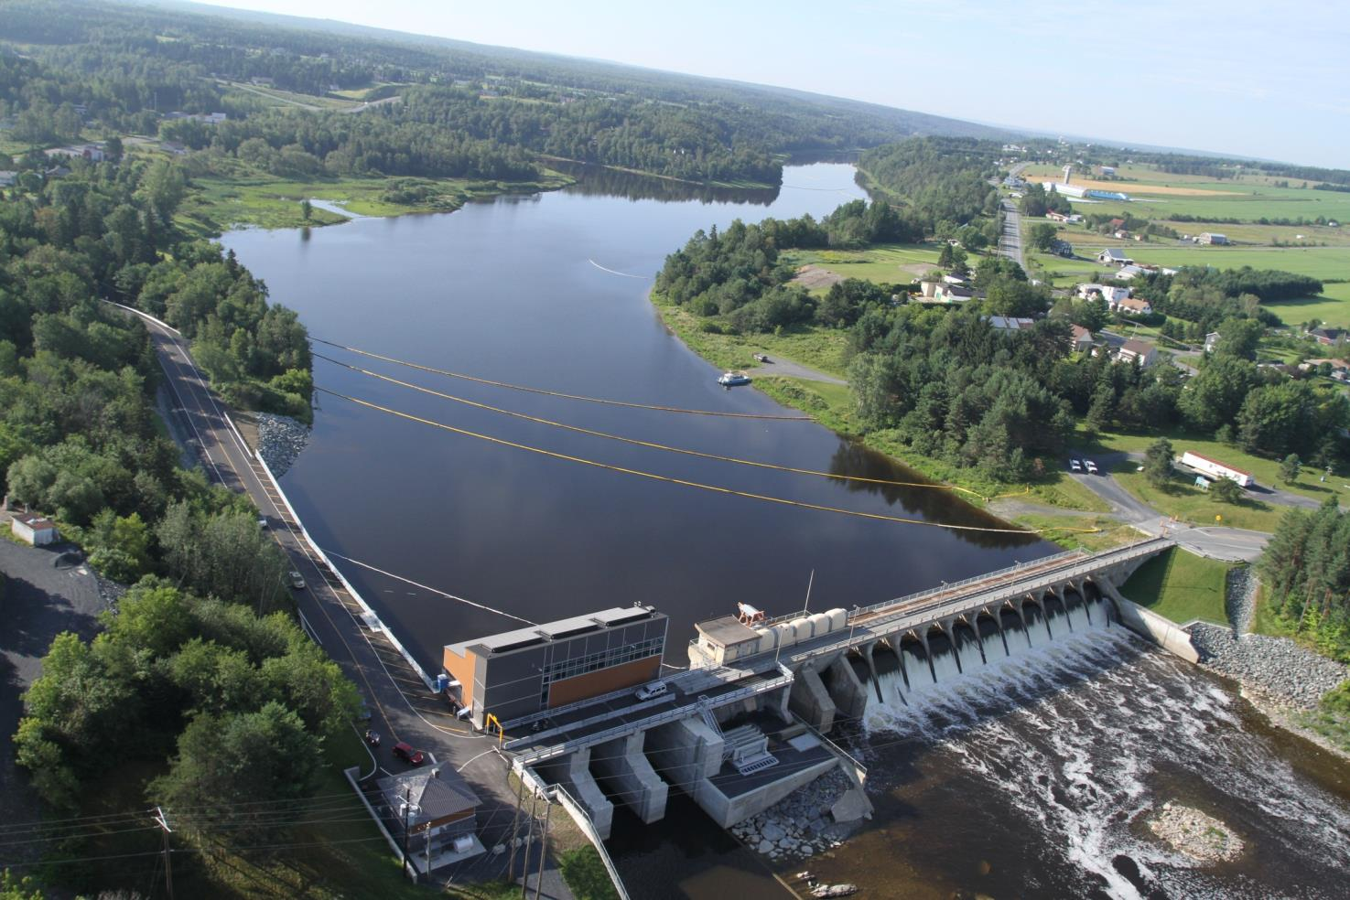
Chaudière River - Control Dam

Slide 9
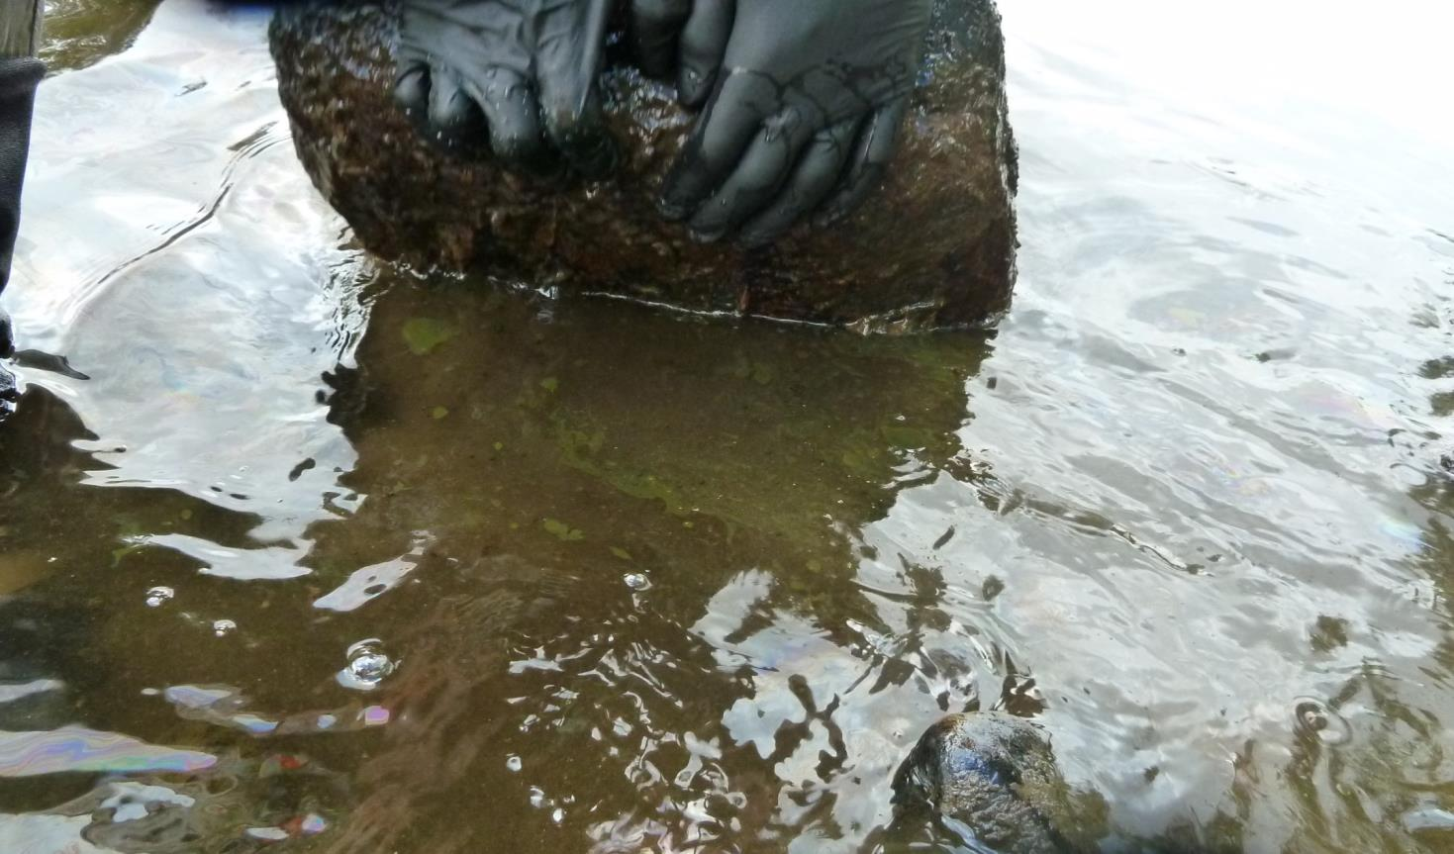
Oil Observed “Submerged”
Notes:
When rocks were lifted up or disturbed oil could be seen to be released as in this picture. The crude was typically a green colour

Slide 10
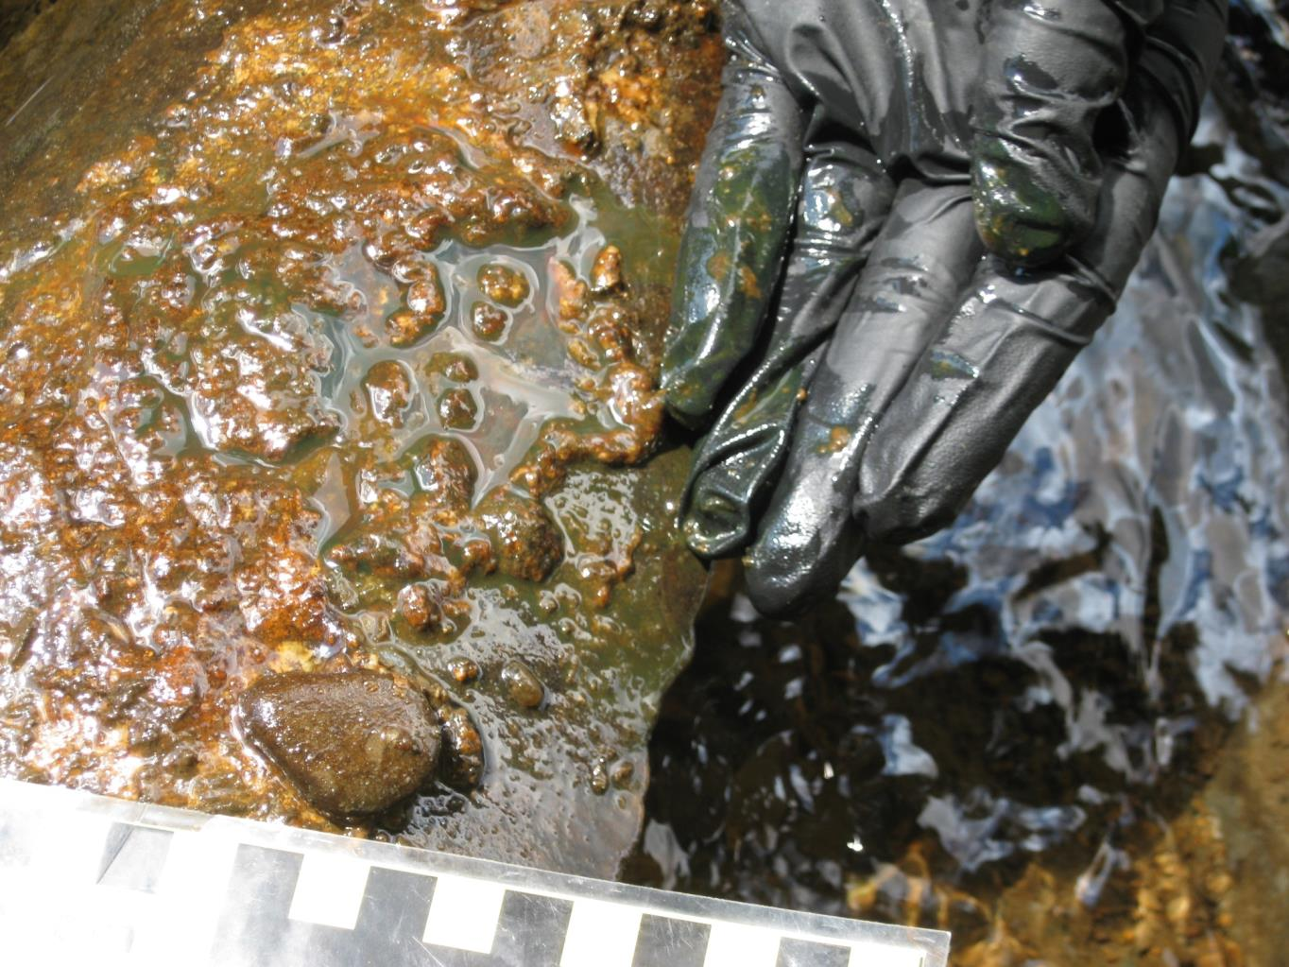
“Submerged” oil under rock
Notes:
The crude could in some cases have a brown/orange ting depending on what it was mixed with after being released. If you look closely at the glove you can see the green oil.

Slide 11
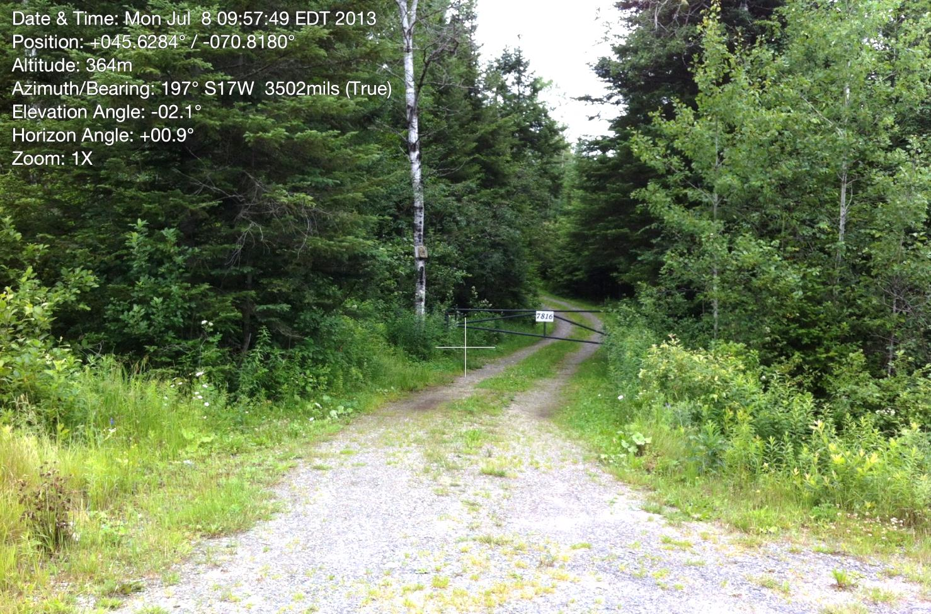
Access Challenges
Notes:
Water front property rights extended into the river – property owner permission was required to gain access for treatment
In some cases access roads/paths had to be created or abandoned ones reopened to gain access.

Slide 12
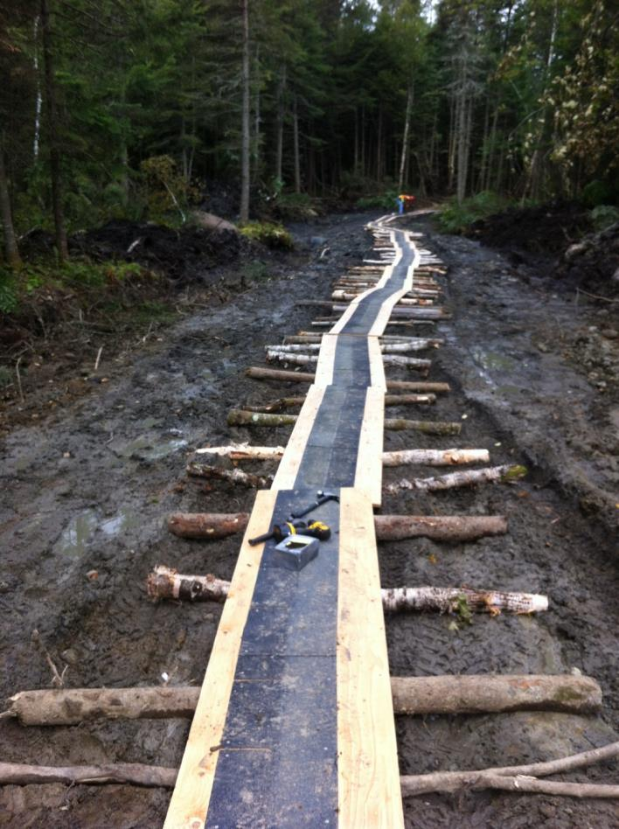
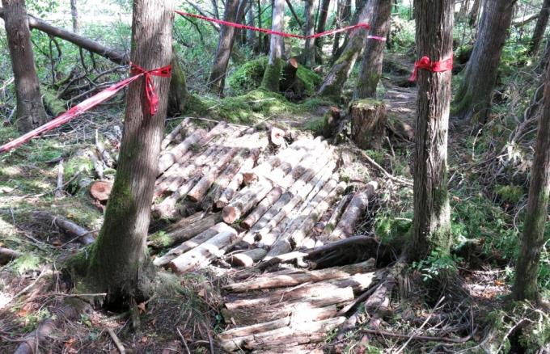
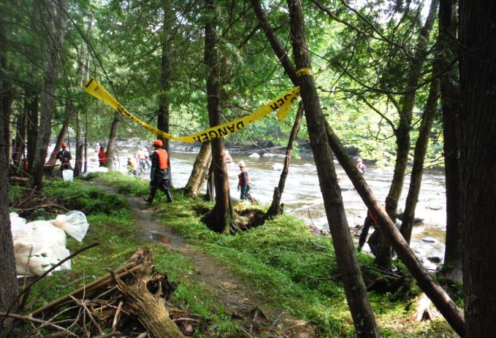
Roads & Trails
Notes:
Many of the access trails were simple mud roads, which could be difficult to transit when wet.

Slide 13
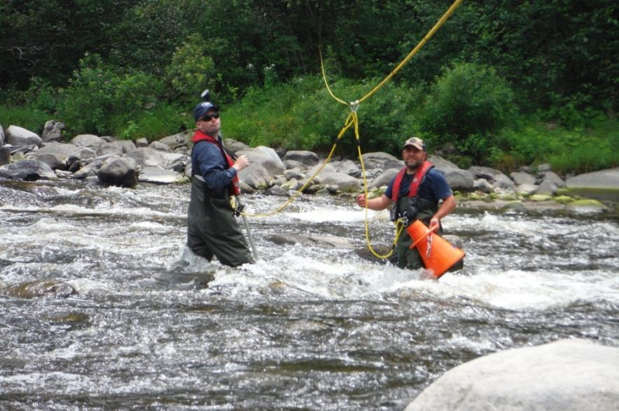
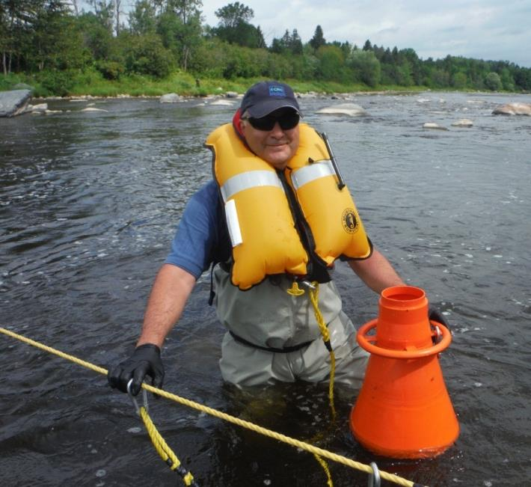
SCAT
In-River Assessment Challenges
Notes:
SCAT process used and adapted for the river including submerged oil. River conditions varied by location and when the control dams were raised or lowered. Worker safety was always a high priority.

Slide 14
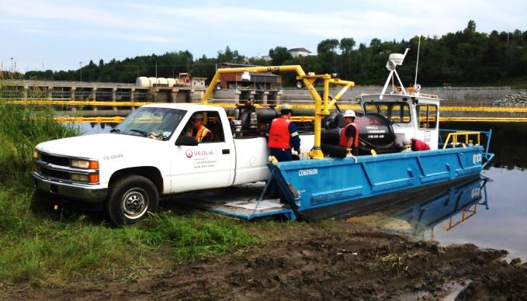
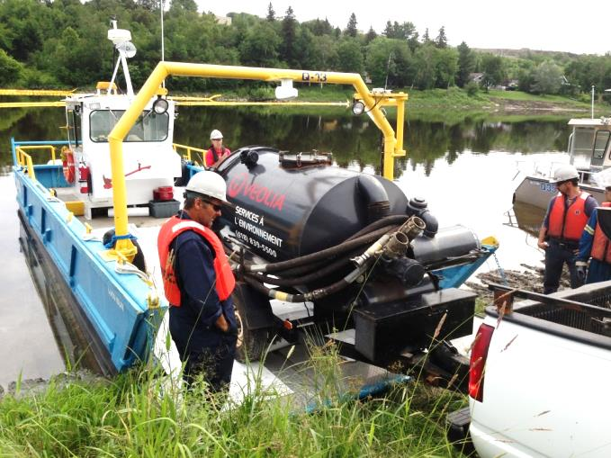
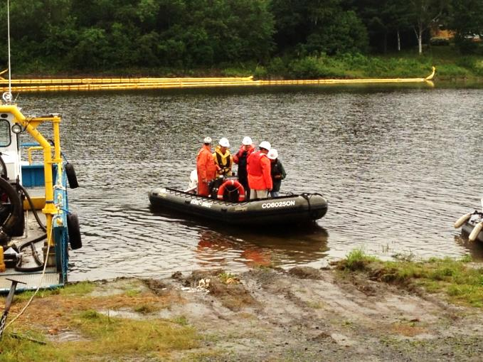
Vessel Operations
Notes:
Some areas allowed for use of larger vessels for equipment and personnel transport and others only small shallow boat or walking with waders.

Slide 15
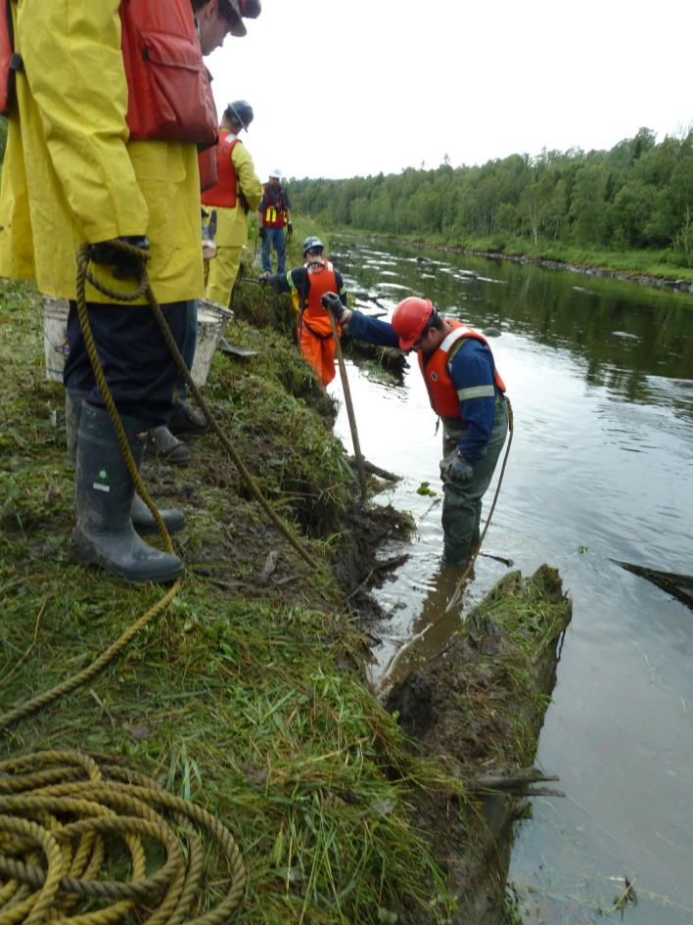
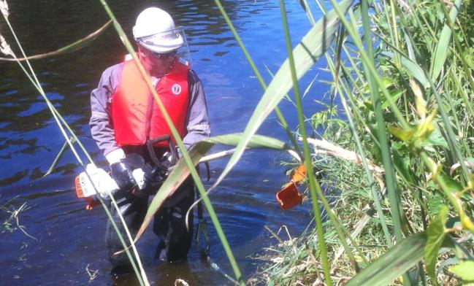
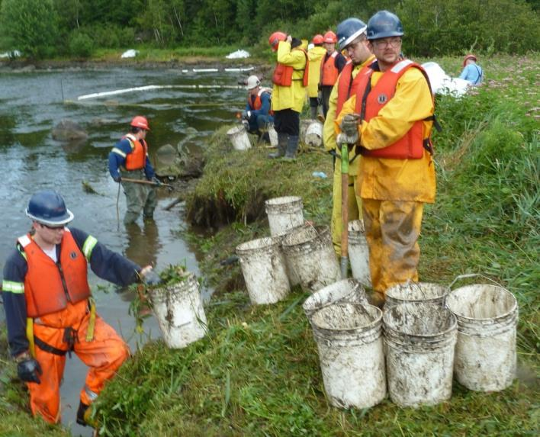
Oiled Vegetation Removal
Notes:
Crude oil in some locations clung to vegetation and had to be removed by selective cutting. In other areas the oil penetrated the bank requiring the removal of the oiled surface layer.

Slide 16
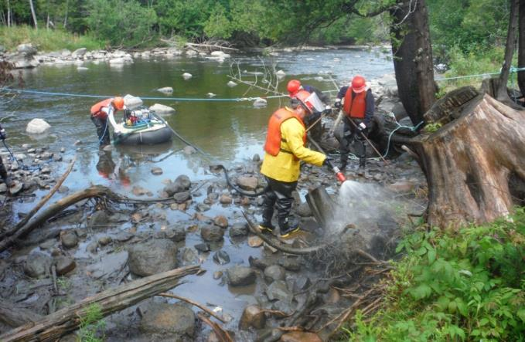
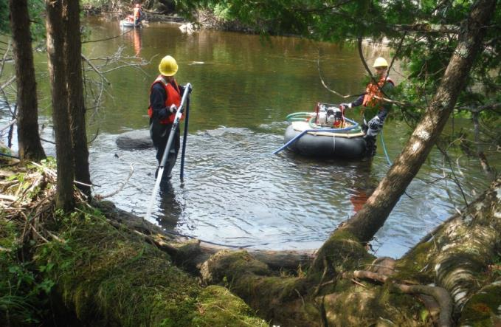
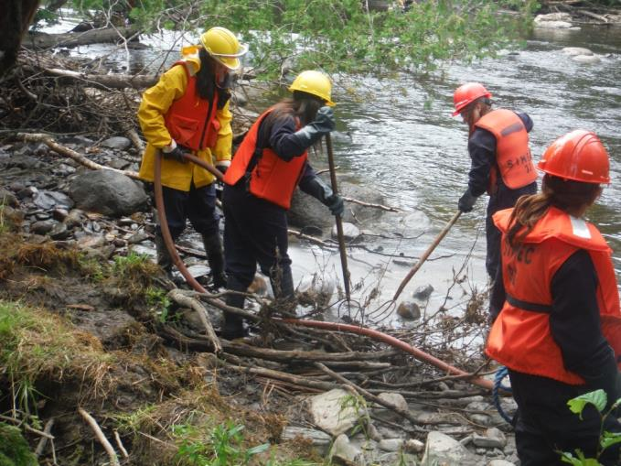
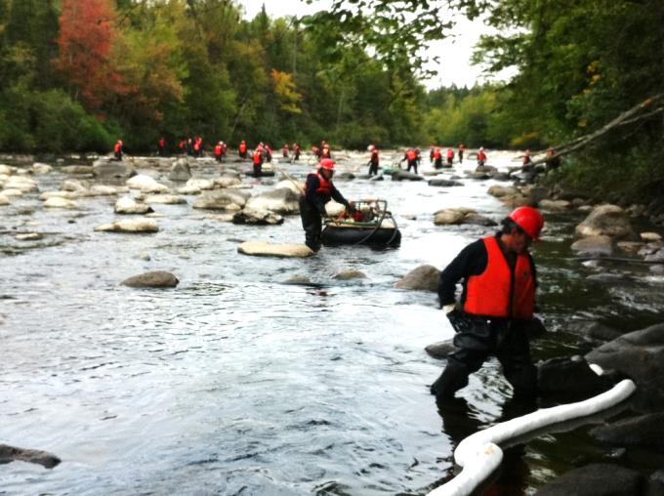
Flushing Operations
Notes:
Some oil was observed trapped between and beneath rocks and debris at the shoreline which was released through flooding and flushing operations.

Slide 17
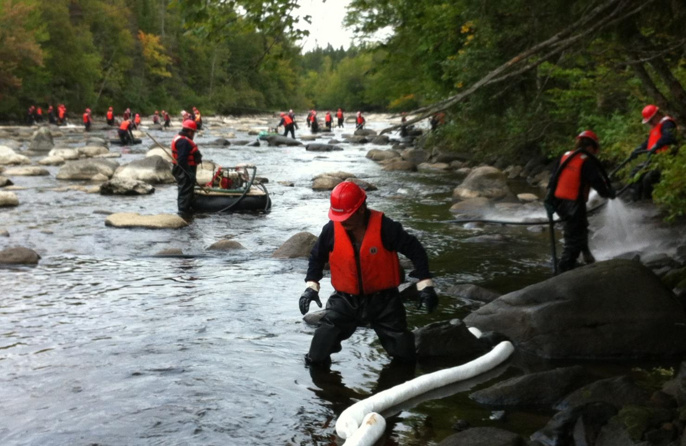
Flushing Operations
Notes:
Water pumps floated on inner tubes in the shallow water were used to supply flushing water

Slide 18
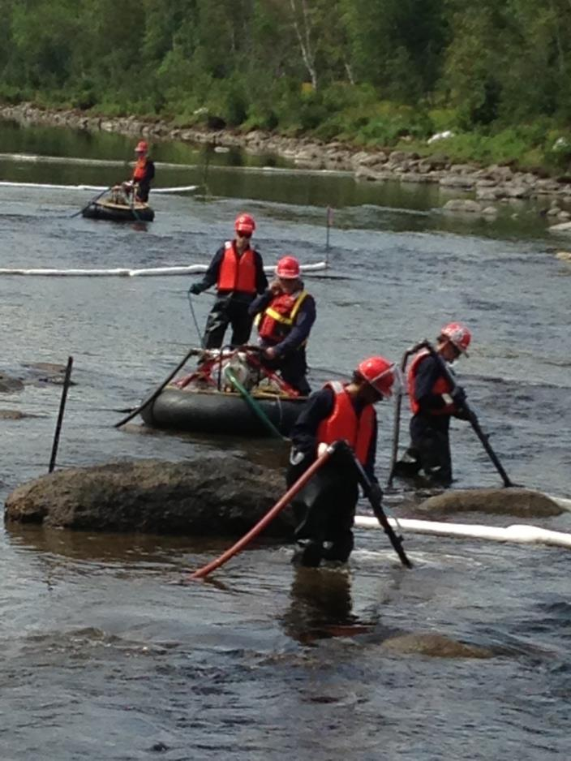
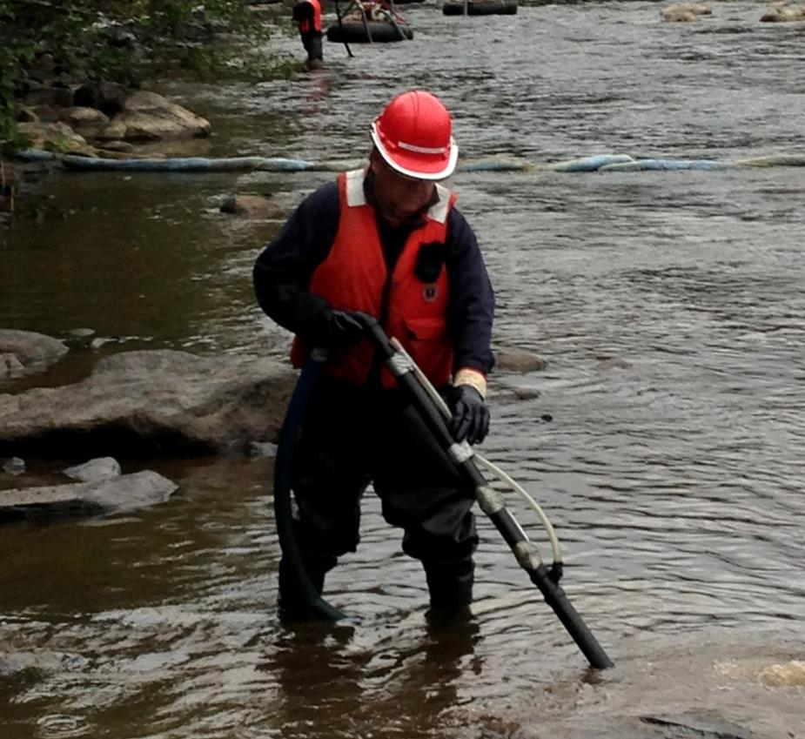
Submerged Oil Remobilization & Recovery
Veturi - Air Injection
PVC - Water discharge lance
Notes:
PVC lances fabricated from plumbing supplies designed to allow water with entrained air to be used to remobilize oil around rocks on the river bed. Oil released was typically small quantity collected by sorbents and nets. Treatment done on a section by section basis typically having collection point every 300-500m.
Quantity of oil trapped believed to be small so decision was made only to use minimal invasive methods and allow natural remediation versus say dredging etc.

Slide 19
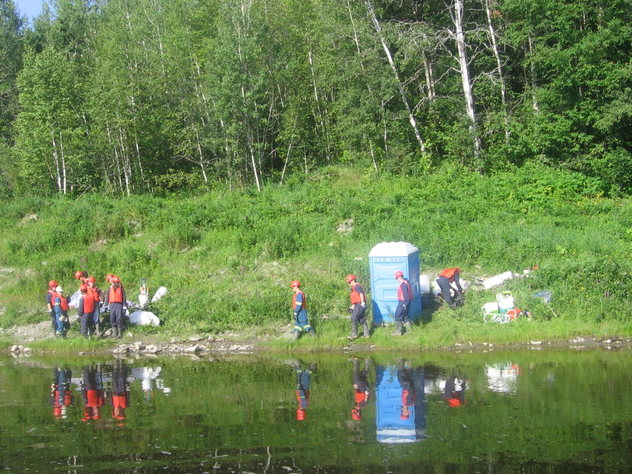
Worker Necessities

Slide 20
Questions???
20

